Slide 1

Stream and I/O Redirection

Slide 2
Introduction

Slide 3
Overview
• As data scientists, we spend a lot of time trying to understand and work with data.
• We need quick ways to preview data or make it easier to work with.
• Today, we will show you how we can be efficient using the terminal to quickly summarize data for us without having to write a python script or open jupyter notebook.

Slide 4
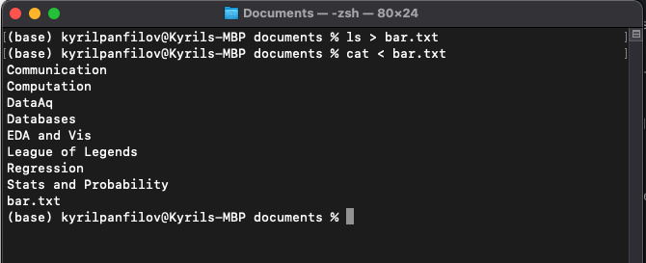
Standard Input/Output
• Standard Input
cat < foo.txt
• Standard Output
ls > bar.txt

Slide 5
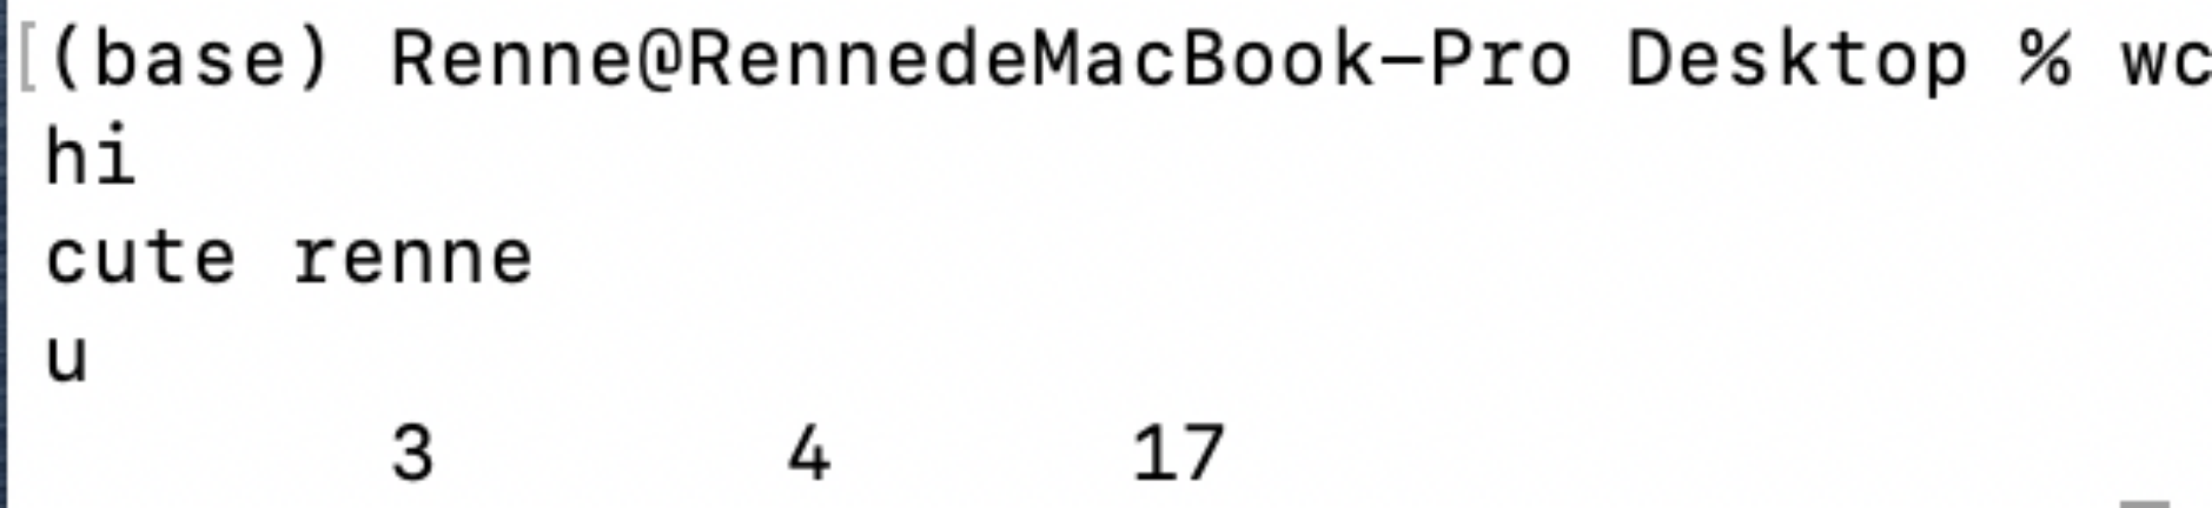
Frequently used command
wc (word count)
# of lines # of words total bytes
grep
search for string in lines/files
|
pass the standard output of one program to the standard input of another program

Slide 6
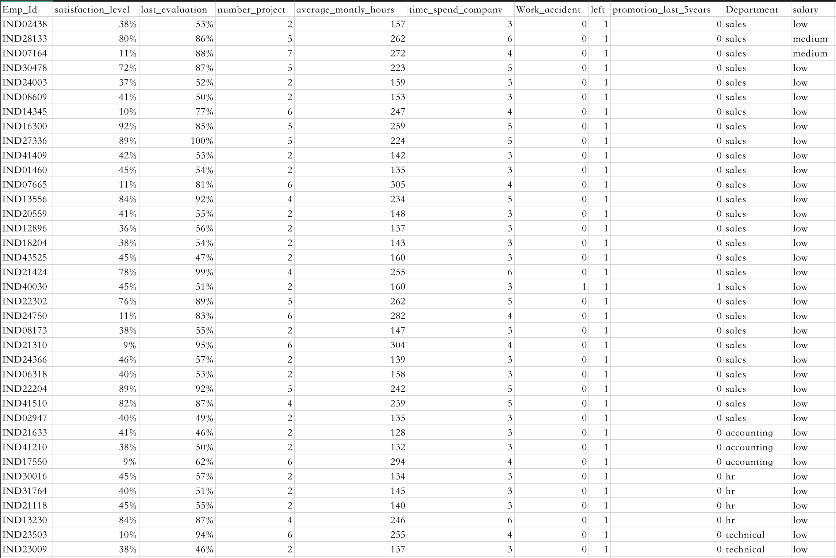
output.csv
How many lines in this csv?
wc output.csv
How many people in Sales department?
grep 'sales' output.csv | wc
# of lines # of words total bytes
What if we want to save the result?
grep 'sales' output.csv | wc > result.txt

Slide 7
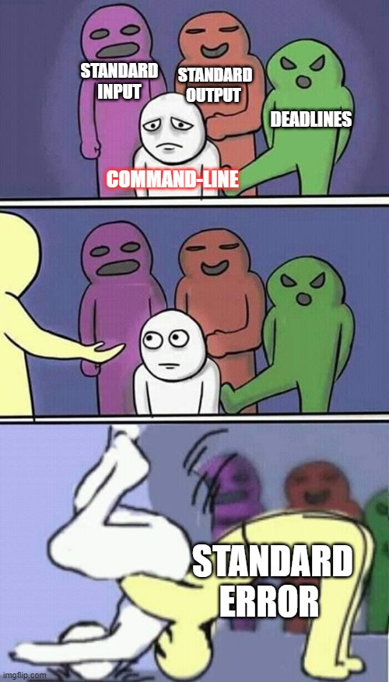
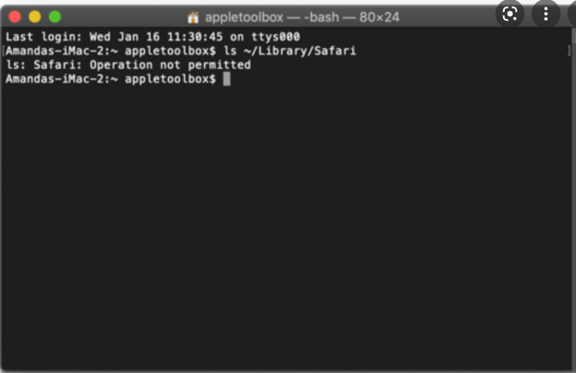
Standard Error

Slide 8
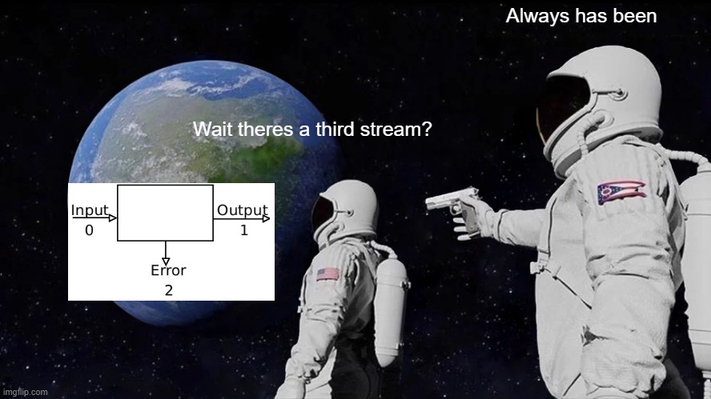
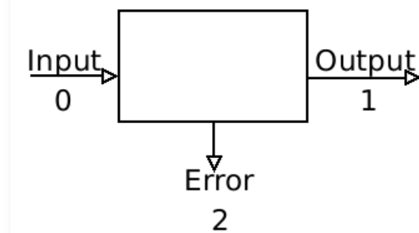
What is standard error?
Is the third place for file output also known as STDERR
It is a stream independent of input and output
Default error output device: terminal
Default input stream: keyboard

Slide 9

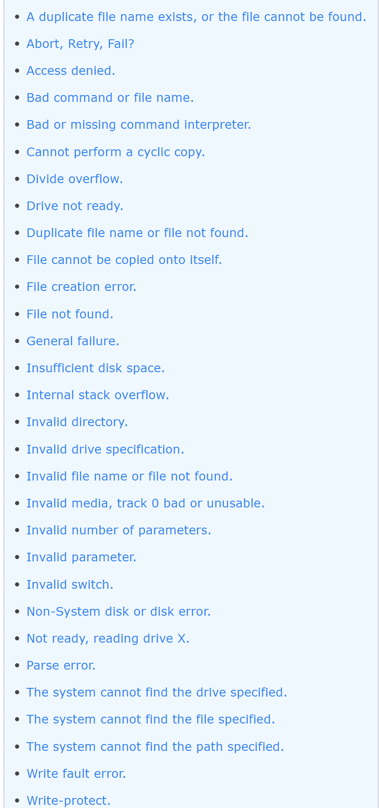
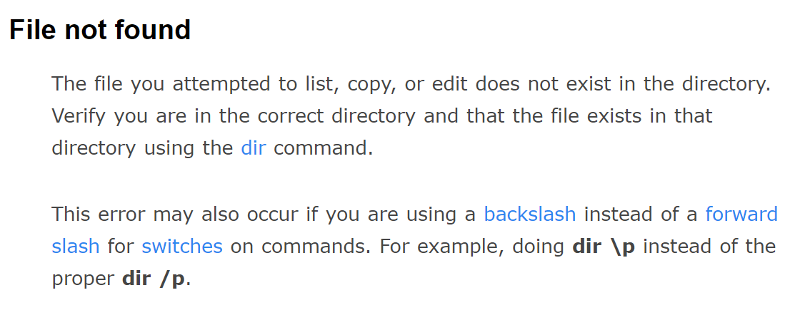
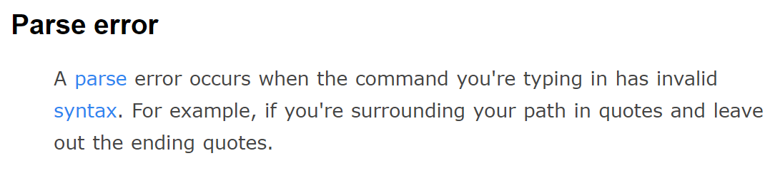

How to interpret Standard error?
29 STDERR
https://www.computerhope.com/doserror.html

Slide 10

Fixing a Standard Error
Don’t panic
Read the error
Google if not easily fixable
When in doubt Ctrl-c gets you out (then esc)

Slide 11
Streams and Redirection with csvkit

Slide 12
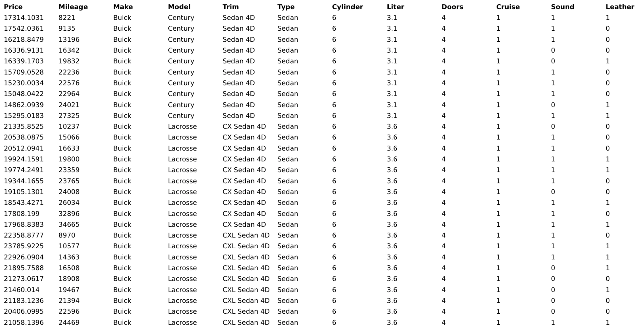
Streams and Redirection with csvkit

Slide 13
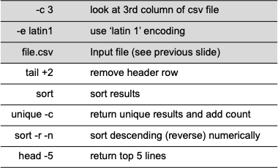
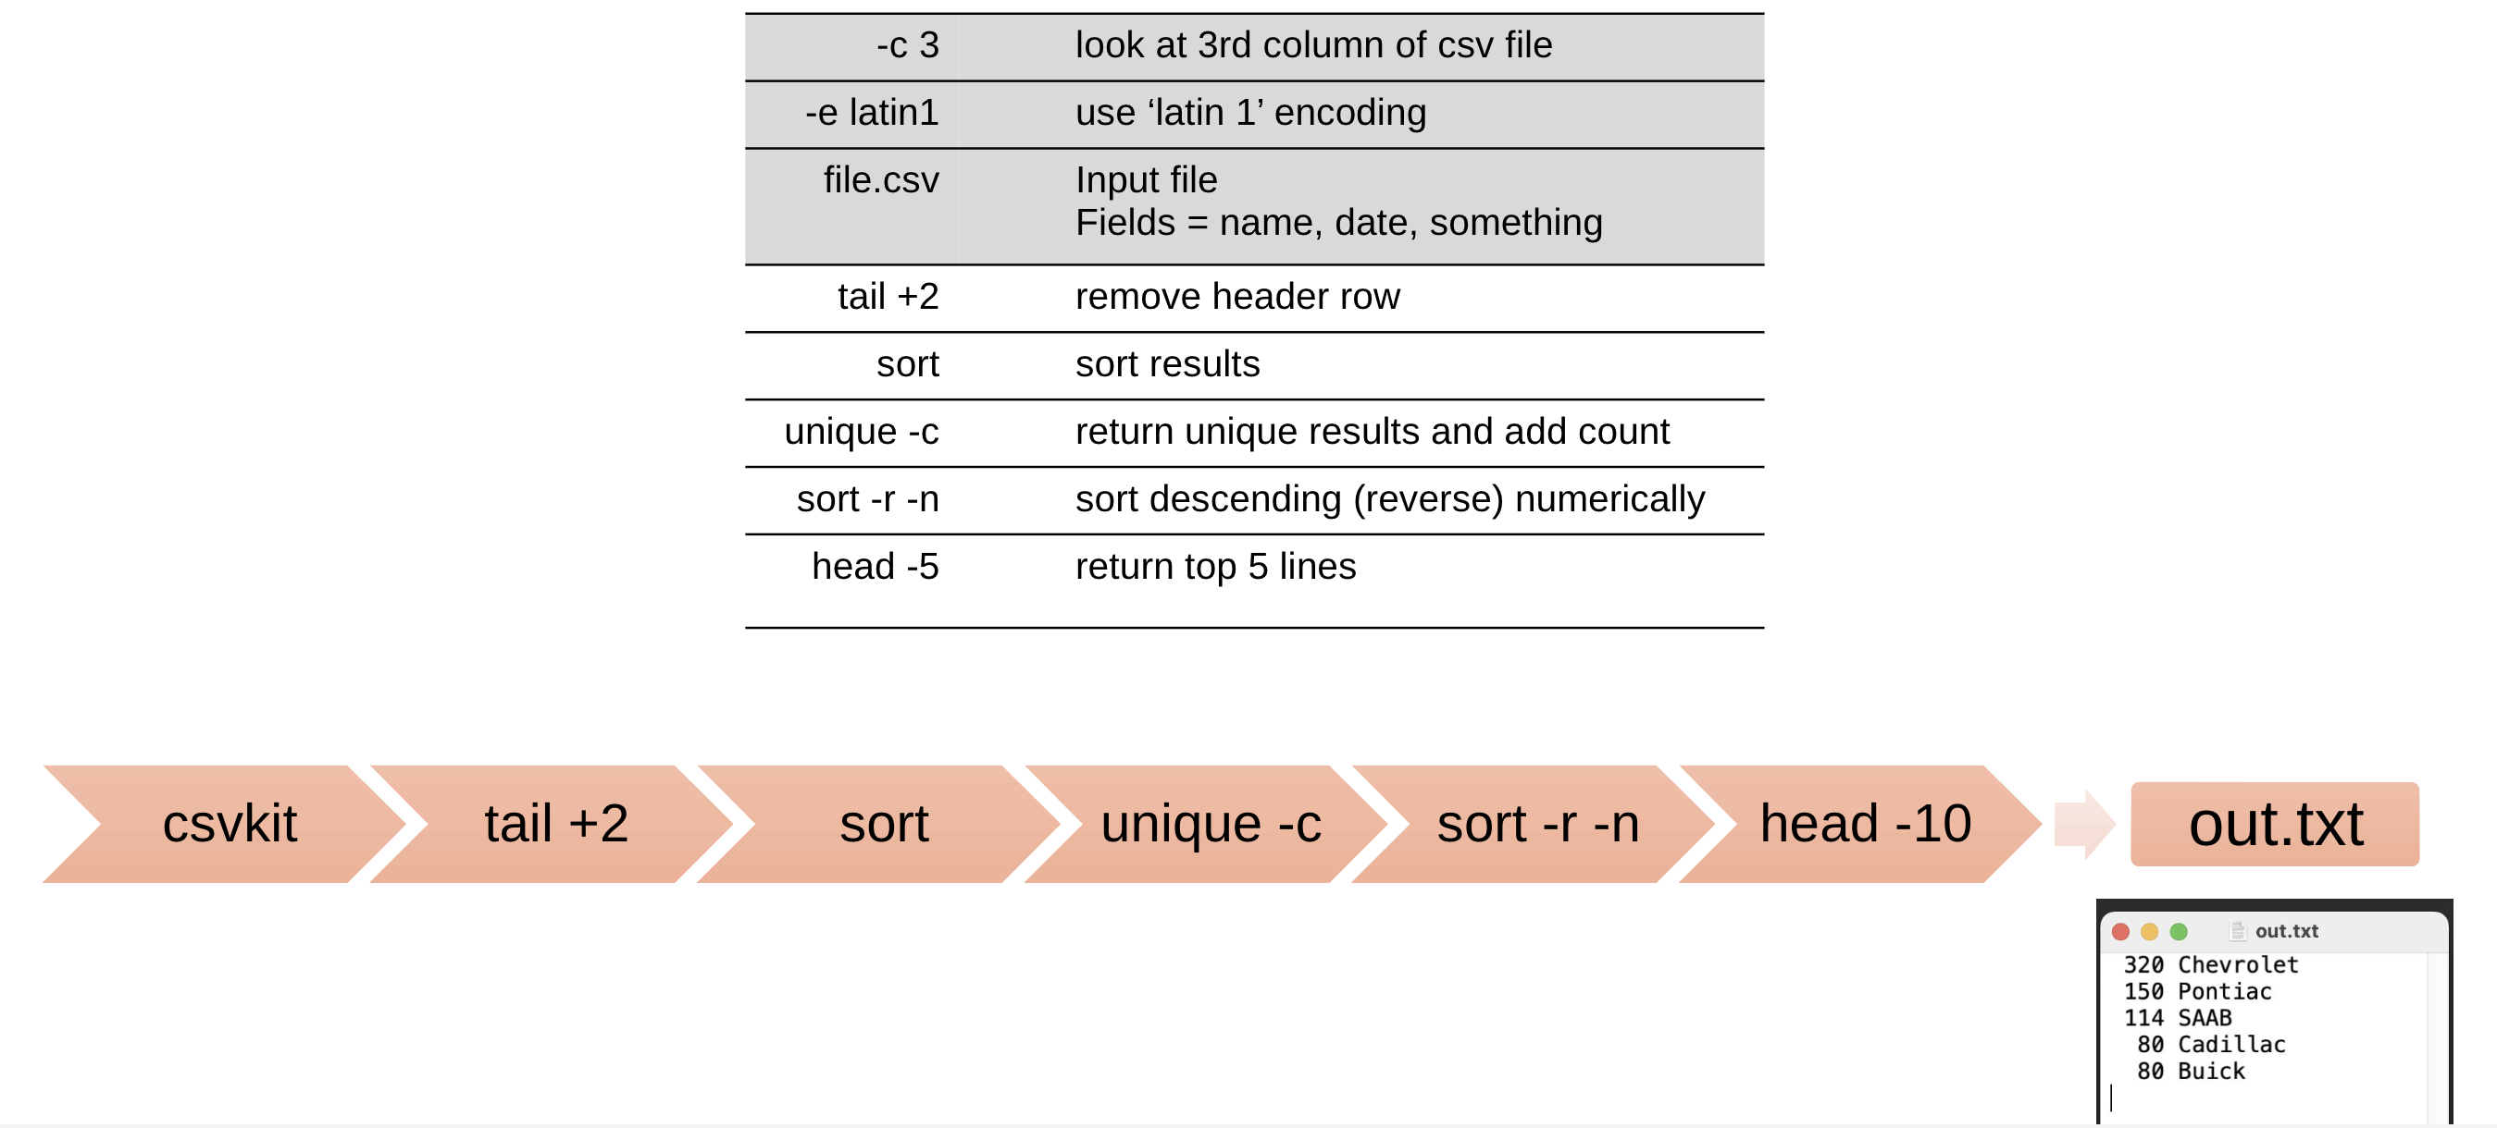
Streams and Redirection with csvkit
csvcut -c 3 -e latin1 file.csv | tail +2 | sort | uniq -c | sort -r -n | head -5 > out.txt

Slide 14
Conclusion

